Slide 1


Department of Computer Science and Engineering
GE19612 – PRIEE
COMMENT ANALYSIS USING SENTIMENT ANALYSIS
HAYAGRIV KOUSHIK S 210701081
HIRTHIK MATHESH GV 210701084
KOUSHIK H 210701125

Slide 2
Introduction
Sentiment analysis on Twitter is a powerful tool for businesses and policymakers due to its real-time data and the brevity of tweets. It provides immediate insights into public opinion, making it a valuable tool for brand monitoring, customer feedback analysis, and gauging public reaction to events and speeches. Twitter's rich and dynamic data make it a dynamic source for sentiment analysis. As natural language processing (NLP) and machine learning techniques advance, the accuracy and applicability of sentiment analysis on Twitter are likely to expand, offering even more profound opportunities for understanding and leveraging public sentiment. With over 330 million monthly active users, Twitter offers a valuable corpus for analyzing public opinion on diverse subjects, including politics, product feedback, and social issues.
Department of Computer Science and Engineering

Slide 3
Literature Review
The study evaluates sentiment in tweets using lexicon-based and machine learning techniques, using 17,189 data points and six classifiers. Support Vector Machine and Multilayer Perceptron were found most accurate.
The paper presents a sentiment analysis dataset with over 200,000 reviews from social media, useful for Chinese language learning and natural language processing, enabling easy creation and assessment of sentiment analysis models.
The study utilizes Twitter data for sentiment analysis, achieving a high accuracy of 93.42% using an ensemble classifier, highlighting its importance in understanding consumer opinions.
Department of Computer Science and Engineering

Slide 4
Abstract
Sentiment Analysis involves analyzing the sentiments conveyed in tweets to gain a deeper understanding of the emotions expressed. This process is commonly utilized in data analysis for computational purposes. To begin, it is necessary to source the essential datasets from platforms like Kaggle to facilitate the project. At the initial process basic python packages like pandas, mat plot, sci-kit learn. Once this cleaning process is complete, the refined datasets can be inputted into the model for evaluation. Initially, the comments within the datasets may exhibit biased tendencies. However, through the integration of the ER library, these datasets undergo a transformation using oversampling or down sampling/under sampling, becoming more impartial and allowing for a clearer distinction between positive and negative comments.
Department of Computer Science and Engineering

Slide 5
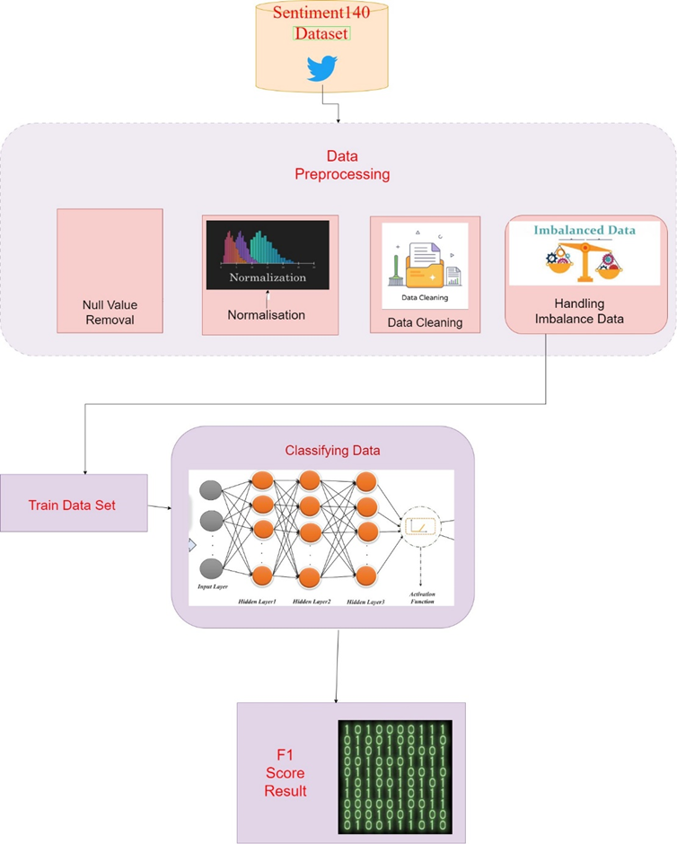
System Architecture
Department of Computer Science and Engineering

Slide 6
List of Modules
INPUT DATA SET
PRE-PROCESSING
TRAINING AND TESTING OF MODULES
HANDLING IMBALANCE DATA
CLASSIFYING THE DATA
F1 SCORE
Department of Computer Science and Engineering

Slide 7
INPUT
it is necessary to source the essential datasets from platforms like Kaggle to facilitate the project. At the initial process basic python packages like pandas, mat plot, sci-kit learn. Once this cleaning process is complete, the refined datasets can be inputted into the model for evaluation.
Initially, the comments within the datasets may exhibit biased tendencies. However, through the integration of the ER library, these datasets undergo a transformation using oversampling or down sampling/under sampling, becoming more impartial and allowing for a clearer distinction between positive and negative comments.

Slide 8
PRE-PROCESSING
Expanding the model's capacity for estimation by adding new features or changing the existing ones. This could involve creating polynomial features, communication terms, or feature extraction from date or text variables.
Combining data from several sources into a single dataset and providing connectivity and consistency across datasets. Decreasing the dataset's feature weigh to boost the accuracy of processing and lower the chance of over fitting. This can be achieved by using methods such as methods of selecting features or principal component analysis (PCA).
Doing the execution of these preprocessing procedures, analysts can ensure that the data is correctly formatted for analysis, leading in more exact and trusted results from machine learning models.

Slide 9
TRAINING AND TESTING OF MODULES
The train dataset's variety and quality of data have significant impacts on the sentiment analysis model's function and ability for generalization. The model is able to recognize reliable patterns of sentiment phrase with the help of a varied dataset spreading a broad range of topics, areas, and writing types. Better labels further ensure that the model develops knowledge from exact ground truth sentiment annotations.
In sentiment analysis, the train dataset gives the data needed for training, evaluation, and efficiency, and it is the base upon which reliable model constructing is built. The ultimate sentiment analysis system's effectiveness and ability for generalization is greatly affected by its quality, variety, and the training techniques used.

Slide 10
CLASSIFYING THE DATA
The method of identifying textual inputs into predefined sentiment categories—typically positive, negative, or neutral—is known as sentiment analysis the categorization This is an extensive description of the classification procedure.
The written data has been preprocessed to create standards and clean the input before classification. Stop words—common words with little linguistic meaning, like "and" or "the"—and special characters, punctuation, and other noise may need to be eliminated in order accomplish this. The text can also be designated to divide it into individual words or n-grams, which are word sequences.

Slide 11
HANDLING IMBALANCE DATA
In sentiment analysis, handling unbalanced data is vital to producing accurate and reliable outcomes. When one sentiment group occurs in the dataset, it generates unbalanced information, which results in biased models that fall short of on minority classes.
The following are some methods to deal with this problem. Reducing involves not enough or over sampling the majority class, depending on which is chosen. Copying minority class cases or developing artificial samples with methods like SMOTE (Synthetic Minority Over-sampling Technique) are instances of the oversampling techniques. To equalize the data set, under sampling decreases the number of cases of the majority class.

Slide 12
F1 SCORE
The F1 score gives an honest assessment of the model's performance through putting both recall and accuracy into a single number. It is computed as the precision and know harmonic means, with the same weight assigned to each metric.
As such, models with low recall or accuracy are affected by the F1 score, resulting in a balance among the two. A high F1 score is often chosen in sentiment analysis applications as it shows that the model reduces false positives and false negatives while correctly recognizing positive, negative, and neutral sentiment in the text.
An F1 score is a helpful indicator to measure the overall effectiveness of sentiment analysis systems because it shows that the model is capable of predicting sentiment across different types of written content.

Slide 13
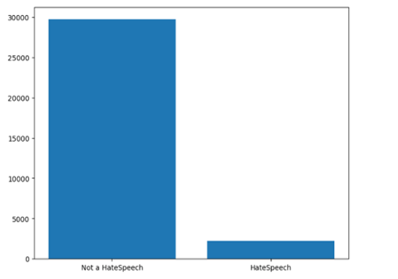
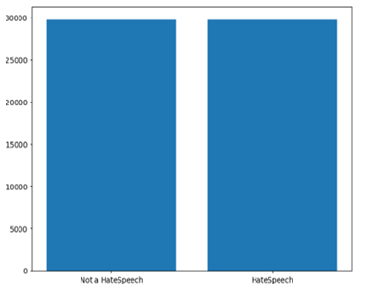
Implementation/Results of Module
Before Sampling After Sampling
Department of Computer Science and Engineering

Slide 14
Conclusion
Since Twitter is one of the biggest names in social media, plenty of studies has been done on sentiment analysis using the tweets. In this research, we discuss the initial findings of the system we propose that takes subjects from tweets using natural language processing (NLP) and describes tweet a component's by looking at sentiment words linked to subjects. The results of the research show that the suggested solution performs more effectively than the Alchemy API, but enhancements are still needed because SVM exceeds it. Further research are intended to improve the precision of sentiment analysis.
Phase-II First Review
Department of Computer Science and Engineering

Slide 15
References
[1]Çam, H., Cam, A., Demirel, U., & Ahmed, S. (2024, January 1). Sentiment analysis of financial Twitter posts on Twitter with the machine learning classifiers. Heliyon. https://doi.org/10.1016/j.heliyon.2023.e23784
[2]Zhang, W., & Zhang, S. (2024, February 1). A Structured Sentiment Analysis Dataset Based on Public Comments from Various Domains. Data in Brief. https://doi.org/10.1016/j.dib.2024.110232
[3]Kp, V., Ab, R., Hl, G., Ravi, V., & Krichen, M. (2024, May 1). A Tweet Sentiment Classification Approach using an Ensemble Classifier. International Journal of Cognitive Computing in Engineering. https://doi.org/10.1016/j.ijcce.2024.04.001
Department of Computer Science and Engineering

Slide 16
GitHub Link:
https://github.com/Koushik20000/210701125-CS19621-PRIEE

Slide 17
Thank You
Department of Computer Science and Engineering

